Slide 1

GEO-AI Challenge for Cropland Mapping by ITU
Mohammad Alasawedah

Slide 2
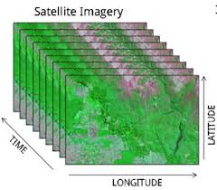
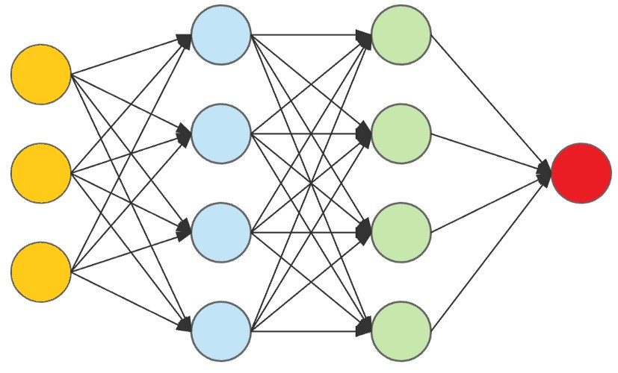
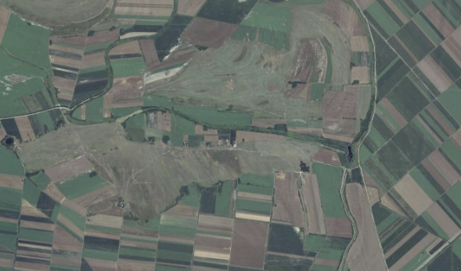
Problem Description – Objective
Time-series Satellite Data
AI/ML Models
Crop Mapping

Slide 3
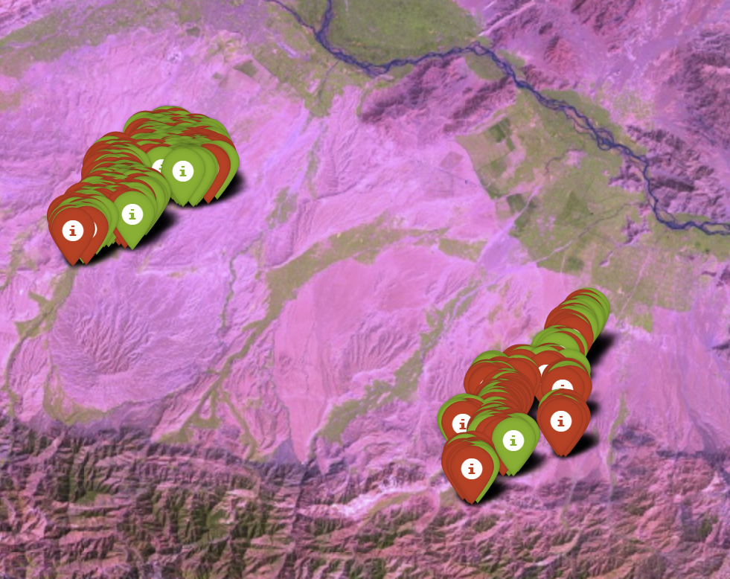
Problem Description – AOIs
Afghanistan
Samples: 500 training & 500 testing
Time interval: April 2022

Slide 4
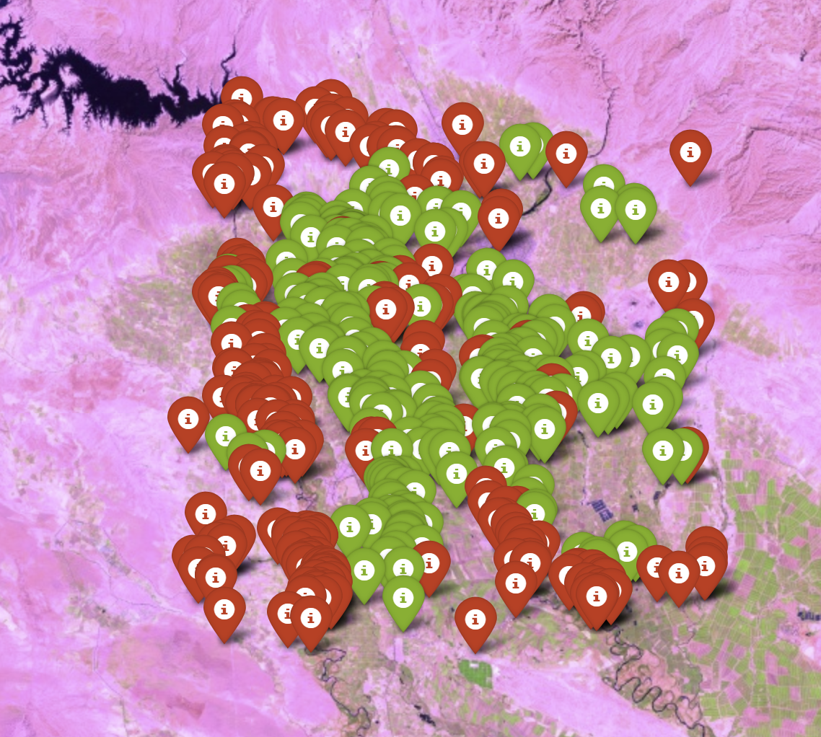
Problem Description – AOIs
Iran
Samples: 500 training & 500 testing
Time interval: July 2029 to June 2020

Slide 5
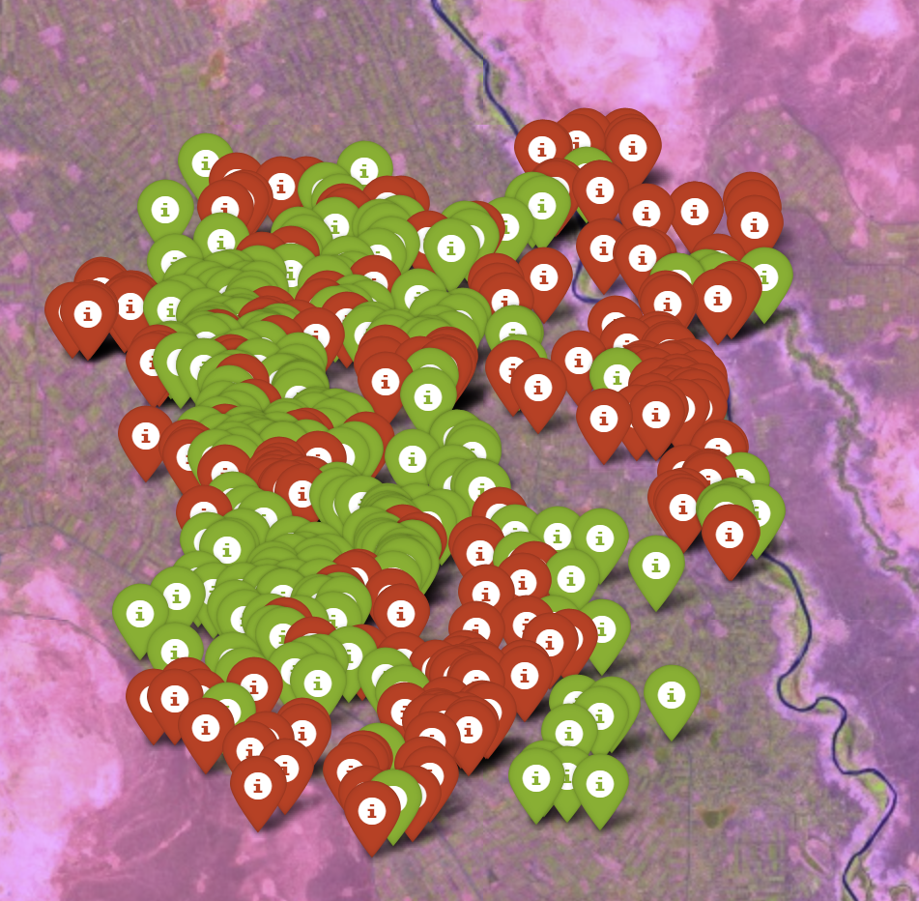
Problem Description – AOIs
Sudan
Samples: 500 training & 500 testing
Time interval: July 2029 to June 2020

Slide 6
Problem Description – Datasets
GEE
Sentinel-2
Sentinel-1
SMAP Level-4

Slide 7
Problem Description – Datasets
Sentinel-2
optical EO data including various spectral bands: B1, B2, B3, ….
Vegetation Indices: NDVI, BSI, ……….

Slide 8
Problem Description – Datasets
Sentinel-1
Synthetic Aperture Radar (SAR) has been used due to its ability to penetrate clouds, including polarization bands VV and VH.
Extract more features like Radar Vegetation Index (RVI).

Slide 9
Problem Description – Datasets
SMAP Level-4
The SMAP Level-4 (L4) Soil Moisture product, include information about soil moisture on different level: top soil layer, root zone.
Other information like evapotranspiration, and leaf area index.

Slide 10
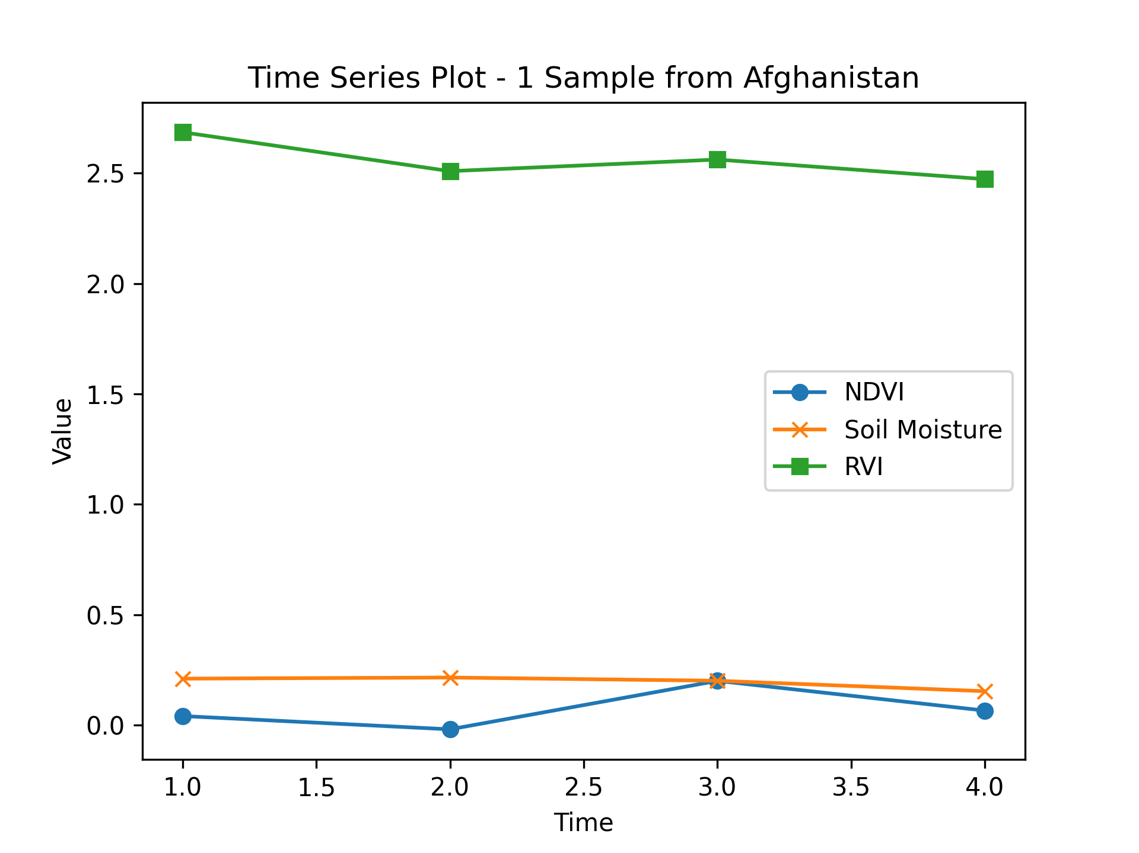
Data Exploration – Timeseries data

Slide 11
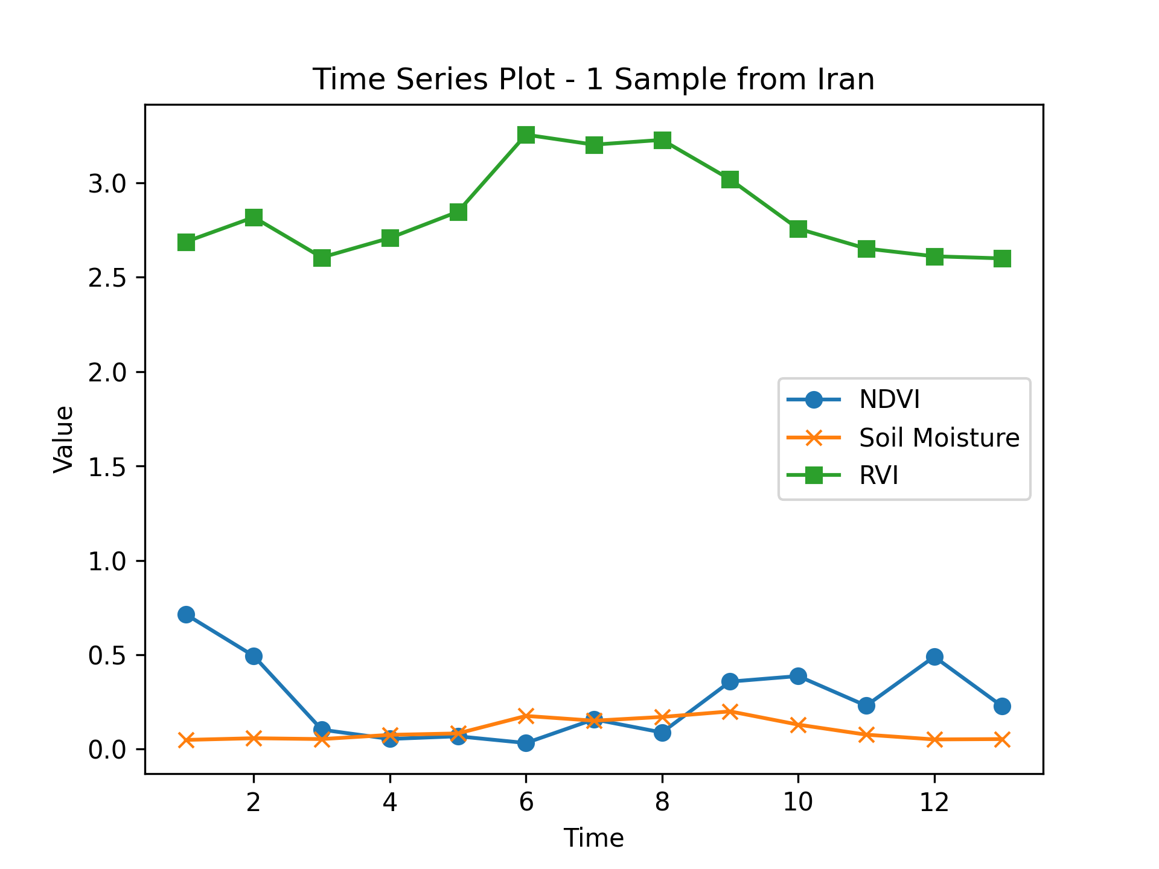
Data Exploration – Timeseries data

Slide 12
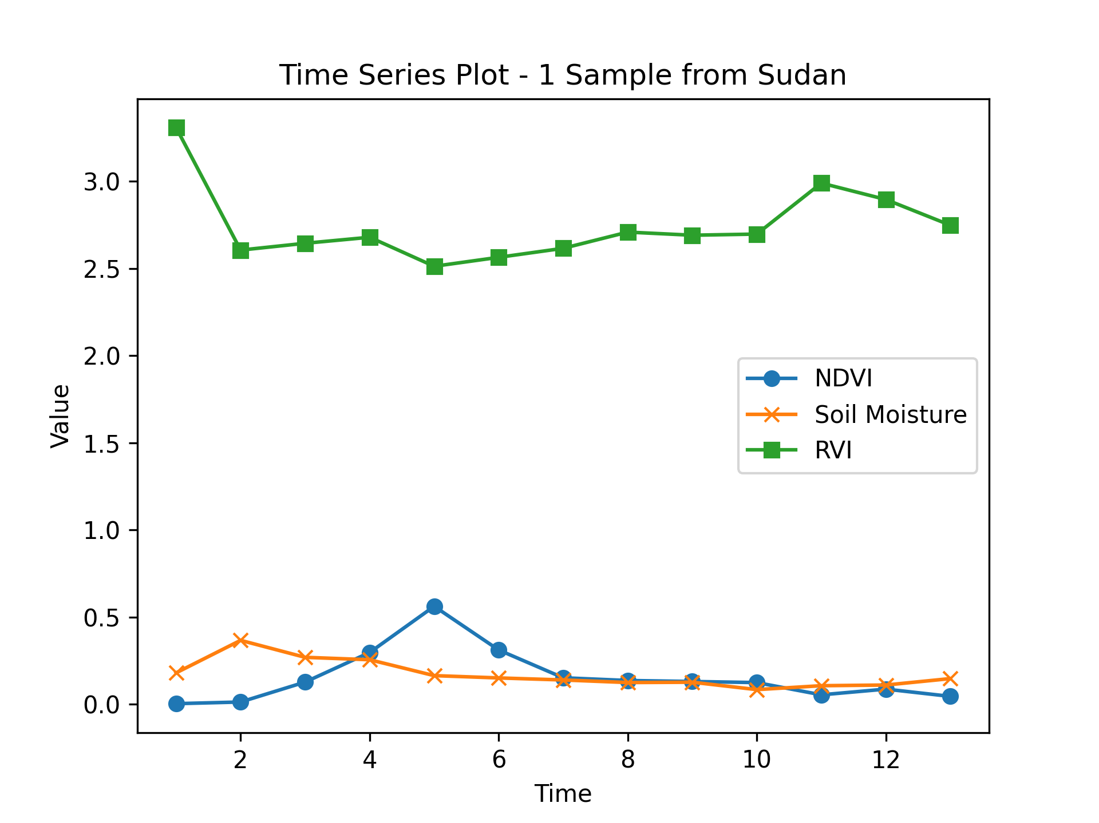
Data Exploration – Timeseries data

Slide 13
Methodology
Restructure into 2-D Dataset
(samples, features)
Ensemble Tree-based Models
LGBM & CatBoost
Training Dataset
Restructure into 3-D Dataset
(samples, features, times)
Timeseries Models
InceptionTime model

Slide 14
Results - Accuracy
AOI | LGBM | CatBoost | Ensemble Model | InceptionTime model
Afghanistan | 0.862 | 0.853 | 0.857 | 0.614

Slide 15
Results - Accuracy
AOI | LGBM | CatBoost | Ensemble Model | InceptionTime model
Afghanistan | 0.862 | 0.853 | 0.857 | 0.614
Sudan | 0.976 | 0.966 | 0.971 | 0.614

Slide 16
Results - Accuracy
AOI | LGBM | CatBoost | Ensemble Model | InceptionTime model
Afghanistan | 0.862 | 0.853 | 0.857 | 0.614
Sudan | 0.976 | 0.966 | 0.971 | 0.614
Iran | 0.970 | 0.952 | 0.961 | 0.598

Slide 17
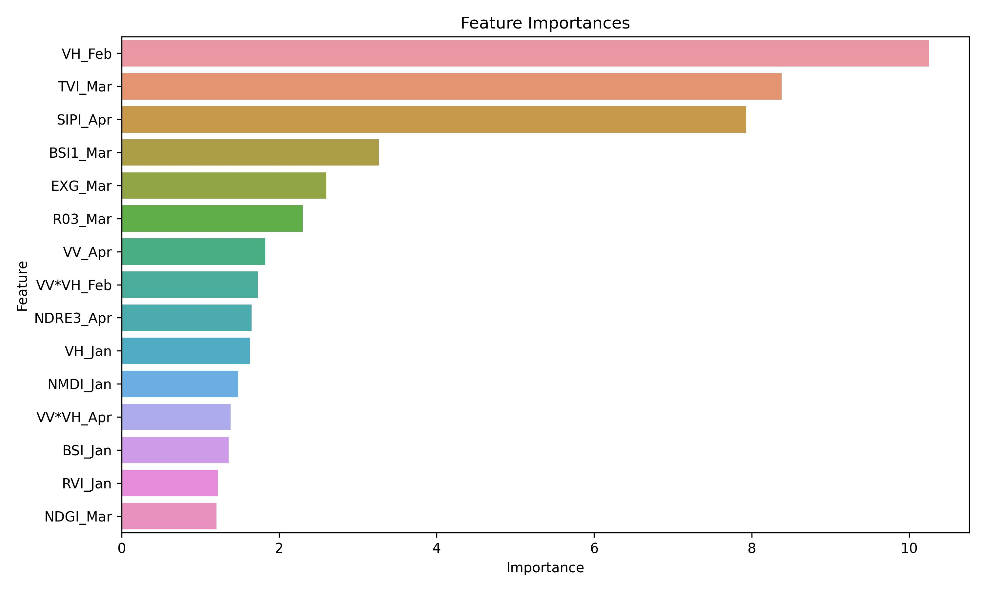
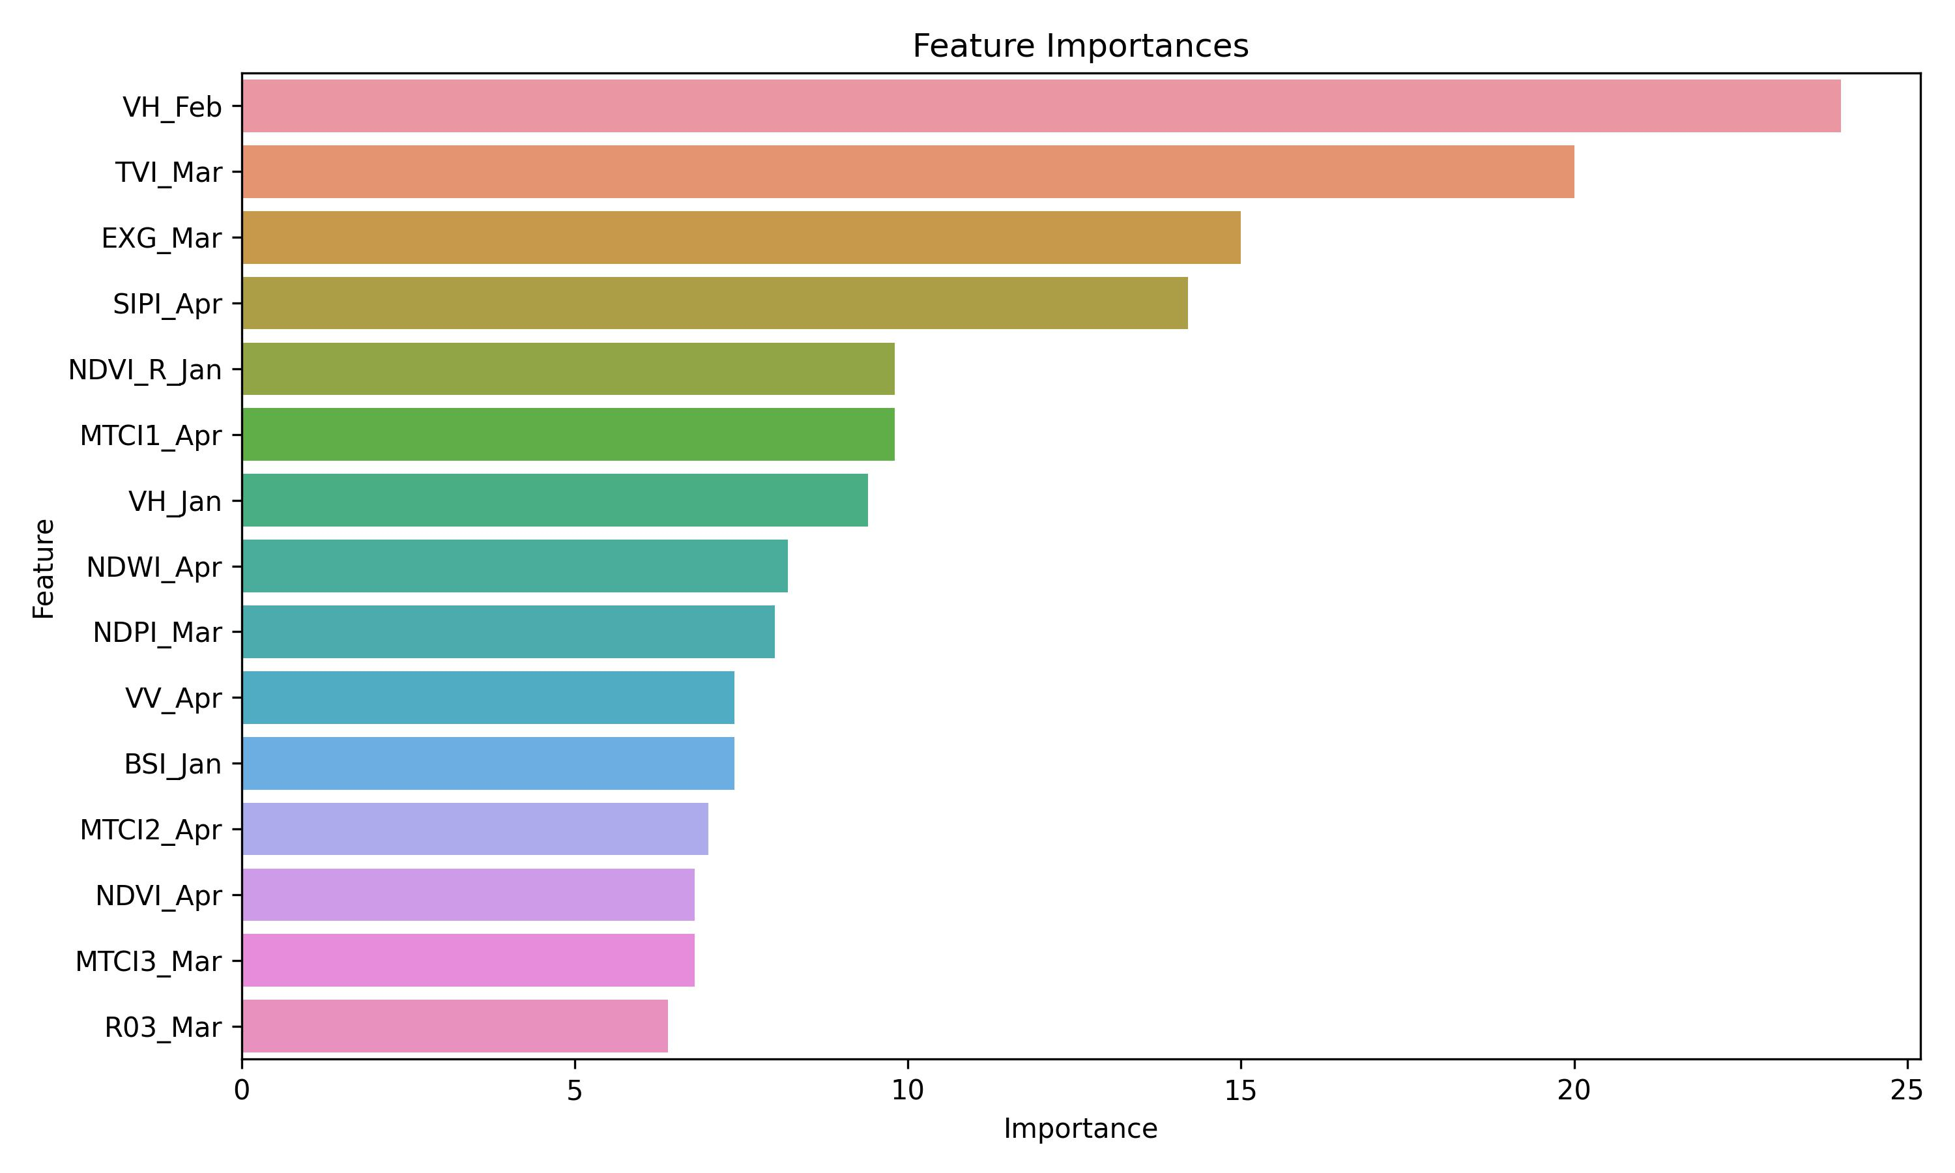
Results – Feature Importance Afghanistan

Slide 18
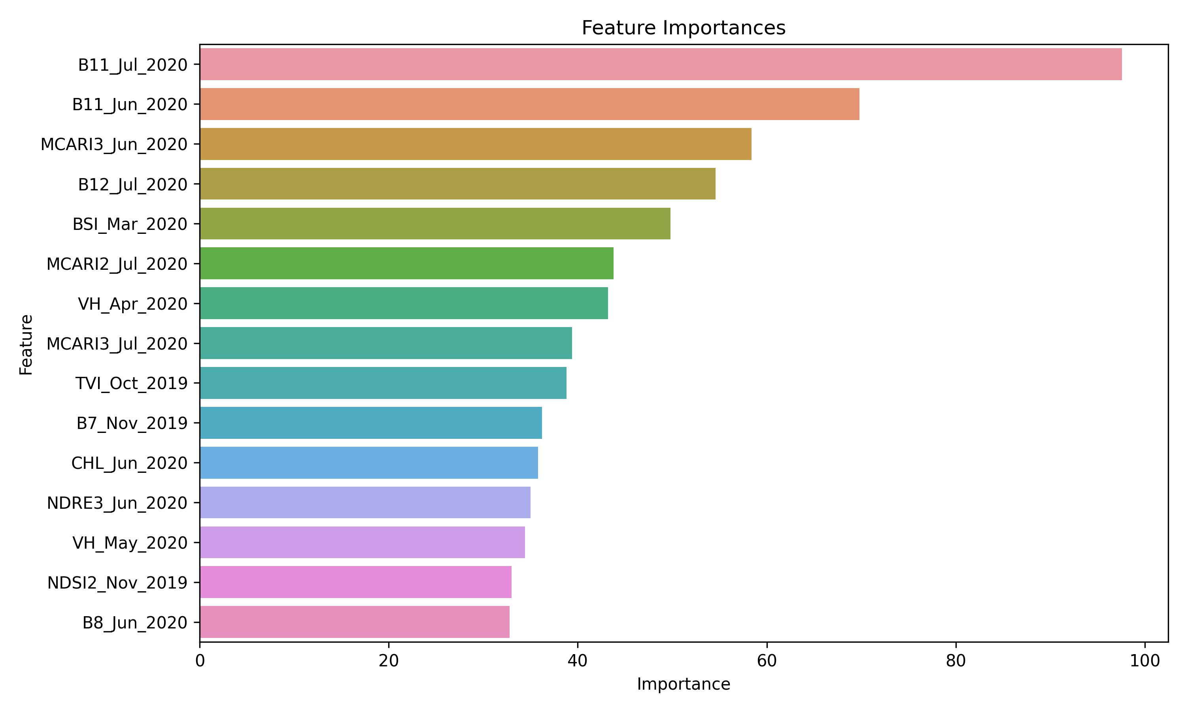
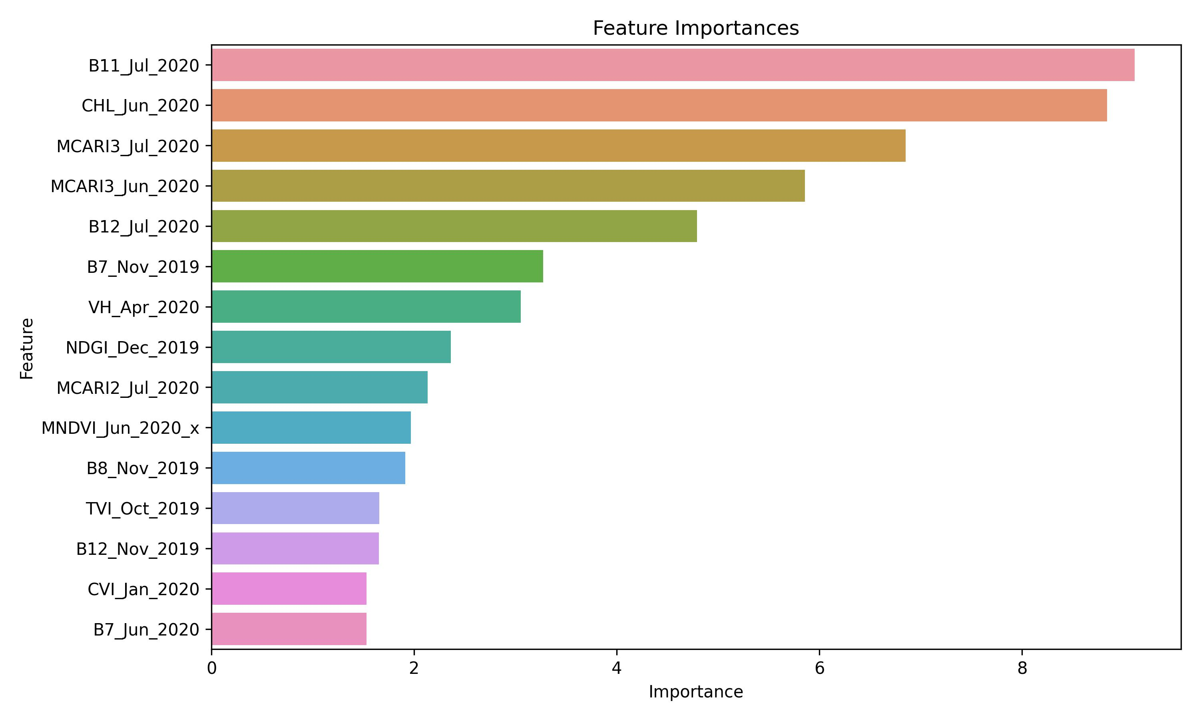
Results – Feature Importance Sudan

Slide 19
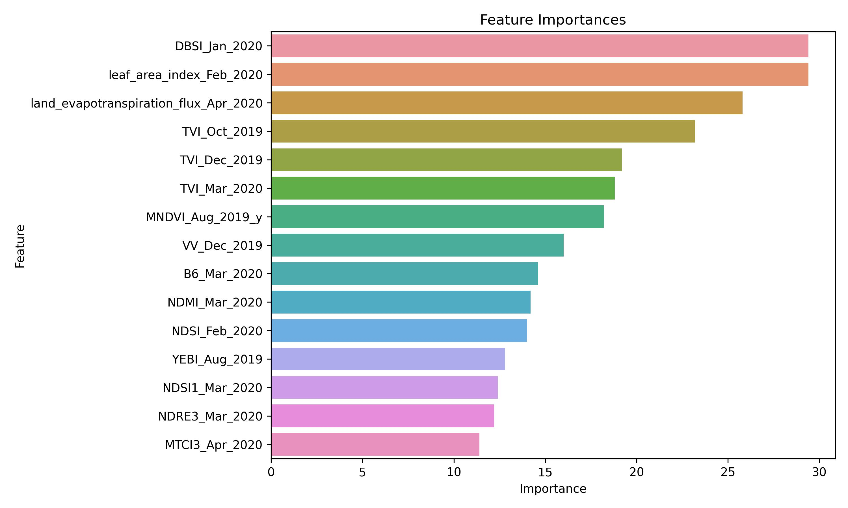
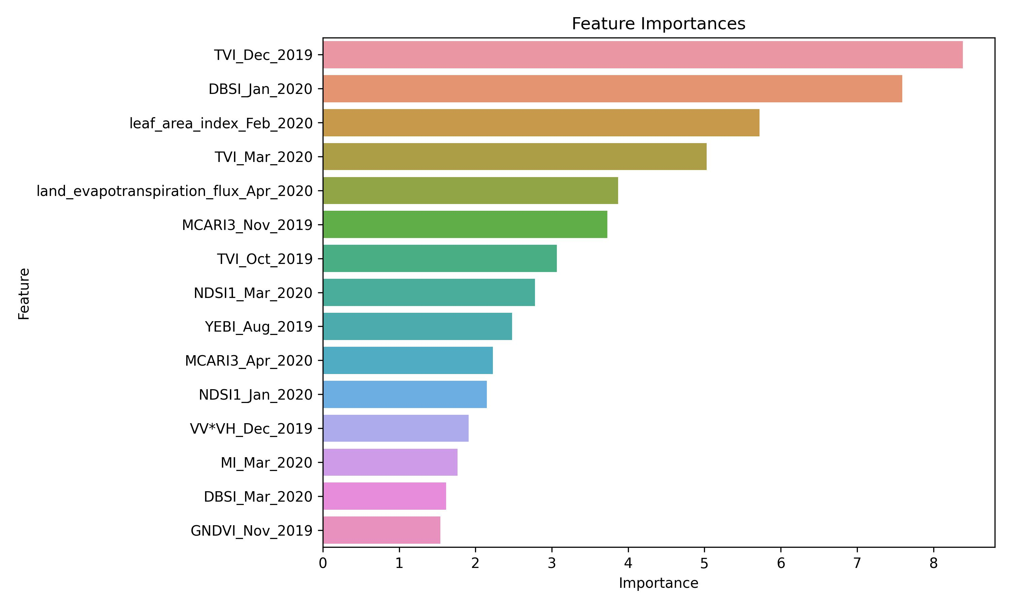
Results – Feature Importance Iran

Slide 20
CONCLUSION
Tree-based models with tabular data, outperformed the time-series model (InceptionTime) using 3D data.
longer time series intervals significantly improved cropland mapping accuracy.
The importance of Sentinel-1 data for cropland mapping is higher in winter.

Slide 21
Thanks

